Slide 1
Cache Memory
UNIT 3

Slide 2
Cache Memory
Cache Memory is a special very high-speed memory. It is used to speed up and works in a synchronous manner with high-speed CPU.
Cache memory is costlier than main memory or disk memory but economical than CPU registers.
Cache memory is an extremely fast memory type that acts as a buffer between RAM and the CPU.
It holds frequently requested data and instructions so that they are immediately available to the CPU when needed.

Slide 3
Cache memory is used to reduce the average time to access data from the Main memory.
The cache is a smaller and faster memory which stores copies of the data from frequently used main memory locations.
There are various different independent caches in a CPU, which store instructions and data.

Slide 4
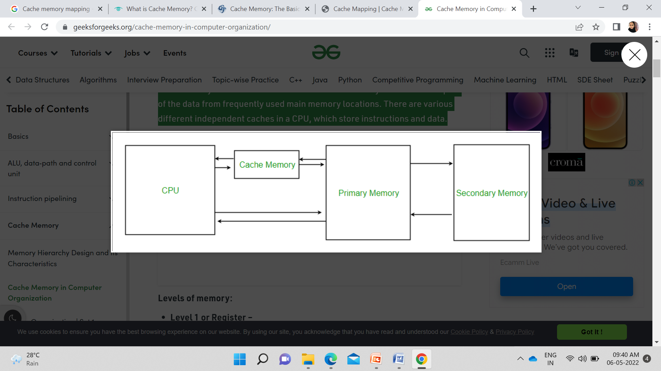

Slide 5
Cache memory or SRAM (static random access memory) is a component of a computer that acts as temporary storage for data that can be accessed by the CPU much faster than if the CPU was trying to get this data elsewhere.
It is usually on the CPU itself or is a chip on the motherboard with its own separate BUS to connect to the CPU.

Slide 6
Cache memory, when compared to RAM memory, is smaller and more expensive
Up to 100 times faster than DRAM memory. This is wildly helpful in increasing the computer’s speed and efficiency.

Slide 7
Cache Hits and Cache Misses
When the CPU requires data, it will check in with the cache memory to see if it contains a reference to that data from the RAM memory address. If it does, it will then pull that data from the cache memory instead of from RAM. This is called a cache hit.
If the processor cannot find the data it is looking for in cache, it will then go on to the standard RAM which takes longer. This is called a cache miss.

Slide 8
Types- Primary / Secondary / Levels
There are two different types of cache memory: primary and secondary.
Primary cache memory is found on the CPU itself whereas secondary cache memory is found on a separate chip close to the CPU.
Although, as time has progressed, the secondary cache has become rather outdated as most caches are found on the CPU.
There are 3 different levels of cache memory that can be on a motherboard:

Slide 9
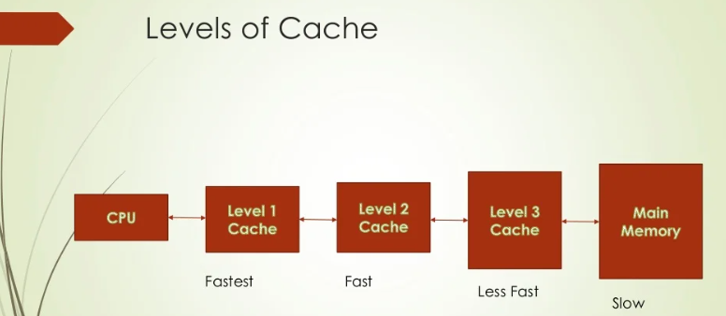

Slide 10
L1: Extremely small and is located on the CPU itself. It is extremely fast but hold only around 32KB of data per core. It is usually embedded in the processor chip as CPU cache.
L2: or secondary cache, is having more capacity than L1. L2 cache may be embedded on the CPU, or it can be on a separate chip.
L3: is specialized memory developed to improve the performance of L1 and L2. L1 or L2 can be significantly faster than L3, though L3 is usually double the speed of DRAM.

Slide 11
Cache memory mapping
Cache mapping is a technique that defines how contents of main memory are brought into cache.
Cache Mapping Techniques-
Direct Mapping,
Fully Associative Mapping,
K-way Set Associative Mapping.

Slide 12
1. Direct Mapping-
In direct mapping, a particular block of main memory can map only to a particular line of the cache.
In Direct mapped cache has each block mapped to exactly one cache memory location.

Slide 13
Conceptually, a direct mapped cache is like rows in a table with three columns: the cache block that contains
the actual data fetched and stored,
part of the address of the data that was fetched, and
a flag bit that shows the presence in the row entry of a valid bit of data. (hit or miss)

Slide 14
2. Fully associative cache mapping
Fully associative cache mapping is similar to direct mapping in structure but allows a memory block to be mapped to any cache location rather than to a prespecified cache memory location as is the case with direct mapping.

Slide 15
3. Set associative cache mapping
Set associative cache mapping can be viewed as a compromise between direct mapping and fully associative mapping in which each block is mapped to a subset of cache locations.
It is sometimes called K-way set associative mapping, which provides for a location in main memory to be cached to any of "N" locations in the L1 cache.

Slide 16
Data writing policies
Data can be written to memory using a variety of techniques, but the two main ones involving cache memory are:
Write-through. Data is written to both the cache and main memory at the same time.
Write-back. Data is only written to the cache initially. Data may then be written to main memory.

Slide 17
END

